Slide 1
Introduction to Lean 4
Wang Yutong@NUS

Slide 2
Prove Theorem by Logic
Simple proof

Slide 3
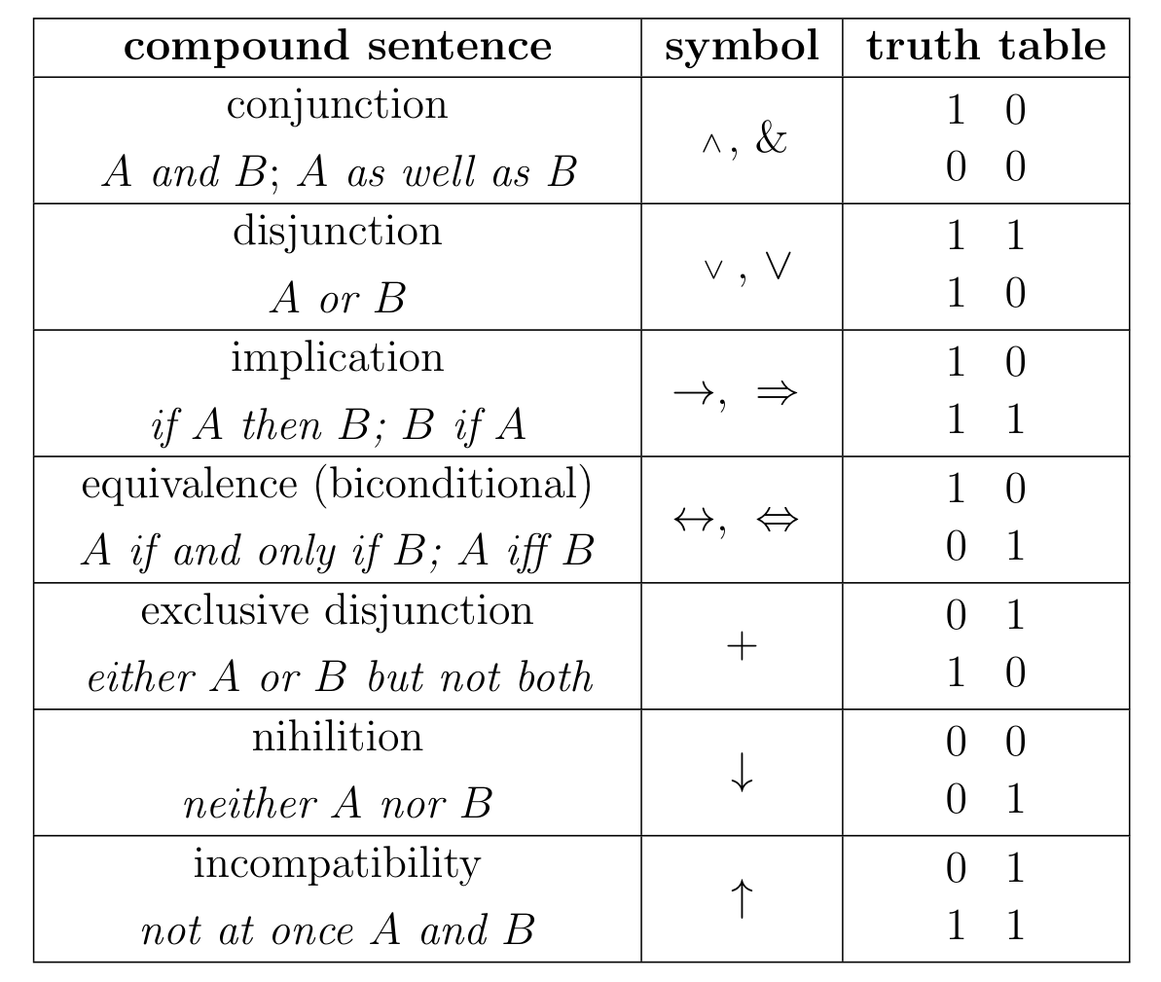
Tactics and proof logic
Logic connectors: and, or
Quantifiers: for all …, exists …
Logic:
Prove by contradiction
Prove by contraposition
Prove by induction (Natural number)

Slide 4
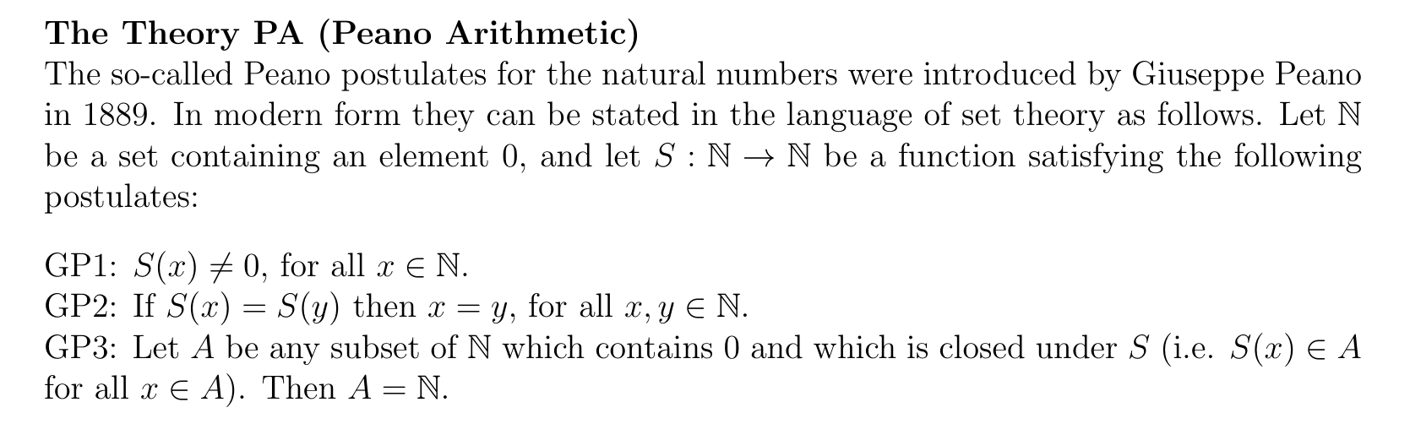
Natural numbers

Slide 5
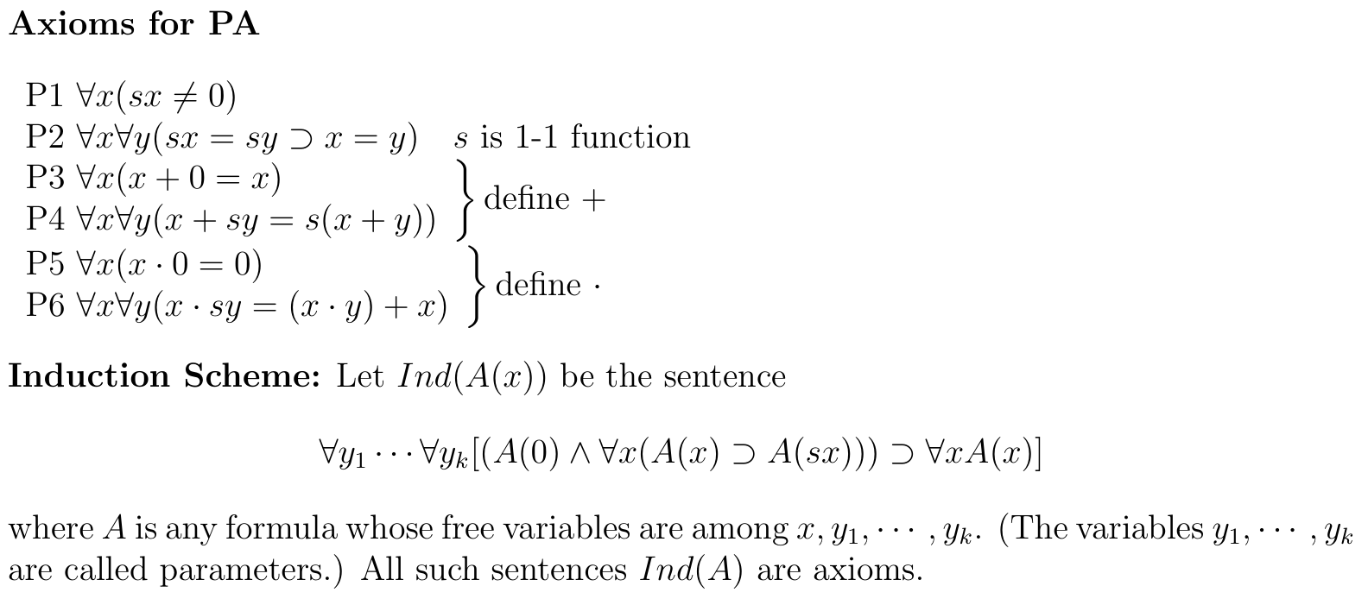
Natural numbers

Slide 6
Extra links

Slide 7
Extra links
Calculus Game Project https://github.com/NUS-Math-Formalization/CalculusSkeleton
HUAWEI Gaokao Project (Contact Me!)
TAS System @ PKU http://101.200.15.5/
Other related stuffs

